Slide 1
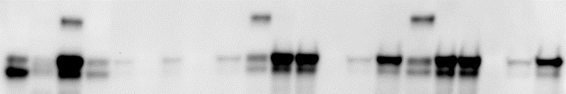
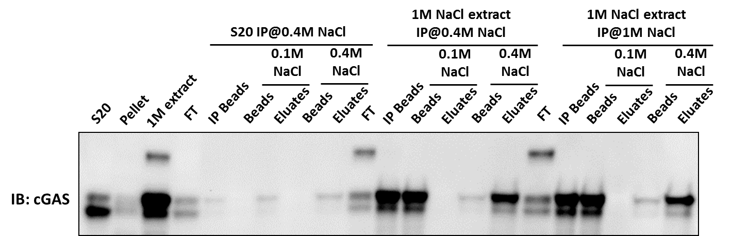
The localization of cGAS (soluble vs. insoluble)
1M NaCl extract IP@0.4M NaCl
1M NaCl extract IP@1M NaCl
S20 IP@0.4M NaCl
0.1M NaCl
0.4M NaCl
0.1M NaCl
0.4M NaCl
0.1M NaCl
0.4M NaCl
1M extract
IP Beads
Eluates
Eluates
IP Beads
Eluates
Eluates
IP Beads
Eluates
Eluates
S20
Pellet
FT
Beads
Beads
FT
Beads
Beads
FT
Beads
Beads
IB: cGAS
cGAS population in S20 is different from cGAS in P20/1M extract, even after IP with 1M NaCl

Slide 2

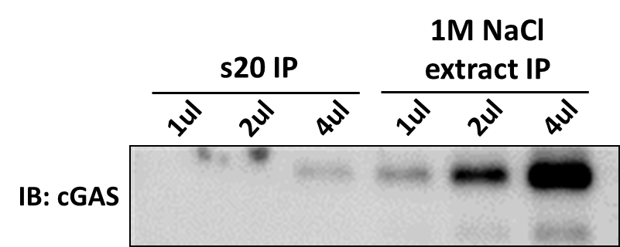
IP cGAS from S20 and 1M NaCl extract
1M NaCl extract IP
s20 IP
1ul
2ul
4ul
1ul
2ul
4ul
IB: cGAS
1: 20ul of IP eluates from S20
2: 20ul of eluates from 1M extract IP
3: 30ng BSA
4: 80ng of (1M_ext 1:5 diluted to 0.5M NaCl)
5: 200ng of (1M_ext 1:5 diluted to 0.5M NaCl)

Slide 3
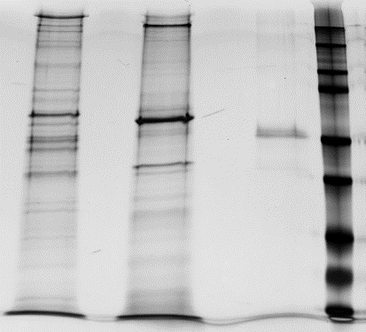
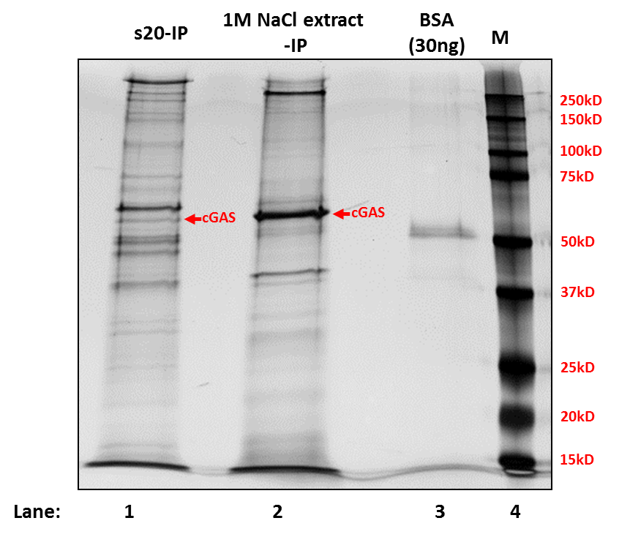
IP cGAS from S20 and 1M NaCl extract
s20-IP
1M NaCl extract
-IP
BSA
(30ng)
M
250kD
150kD
100kD
75kD
cGAS
cGAS
50kD
37kD
25kD
20kD
15kD
Lane:
1
2
3
4
1: 20ul of IP eluates from S20
2: 20ul of eluates from 1M extract IP
3: 30ng BSA
4: 80ng of (1M_ext 1:5 diluted to 0.5M NaCl)
5: 200ng of (1M_ext 1:5 diluted to 0.5M NaCl)
IP_beads after 0.5M eluting
IP_S20
0.5M Elute
IP_1M_ext
0.5M Elute
1ul
2ul
4ul
1ul
2ul
4ul
1M_ext
S20
IB: cGAS

Slide 4
cGAS phosphorylation detected
#2
Phospho: 43/752
S13: 1/42
S23: 1/7
T35: 3/67
S37: 14/67
S64: 4/23
T68: 2/23
S94: 2/37
T97: 2/37
S98: 4/37
T130: 2/39
S143: 5/39
S163: 0/79
S213: 1
Y214: 1
S305: 2/21
S329: 4
#4
Phospho: 1/189
S163: 1/4

Slide 5
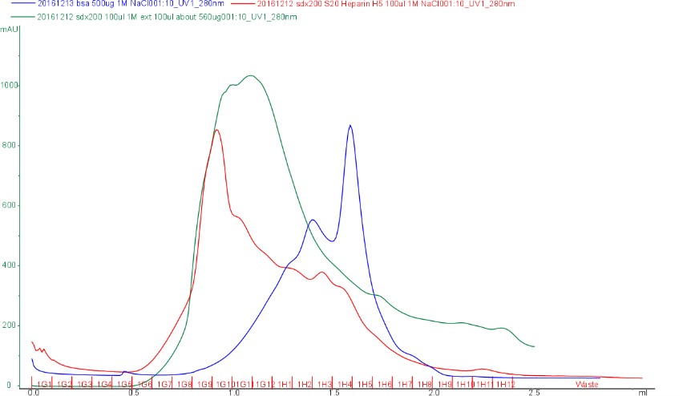
cGAS from 1M NaCl extract and cGAS from S20 (eluate from Heparin column) are applied to superdex-200.
BSA 1.6ml

Slide 6


cGAS from 1M NaCl extract and cGAS from S20 (eluate from Heparin column) are applied to superdex-200.
Elution volume (mL)
SM
0.8
0.9
1.0
1.1
1.2
1.3
1.4
1.5
1.6
1.7
1.8
1.9
2.0
IB: cGAS
SM: 1ml S20 -> Heparin 1ml column (H5 frac.) -> concentrate and buffer exchange to 100ul 1M NaCl buffer
SM
(1M ext)
Elution volume (mL)
S20
0.8
0.9
1.0
1.1
1.2
1.3
1.4
1.5
1.6
1.7
1.8
1.9
IB: cGAS
SM: about 560ug of 1M ext
The molecular weight of cGAS from 1M NaCl (~ 120 kDa) is larger than cGAS from S20 (~ 60 kDa).

Slide 7

Elution volume (mL)
SM
0.8
0.9
1.0
1.1
1.2
1.3
1.4
1.5
1.6
1.7
1.8
1.9
IB: cGAS
SM: Heparin column eluate from s20
Elution volume (mL)
SM
0.8
0.9
1.0
1.1
1.2
1.3
1.4
1.5
1.6
1.7
1.8
1.9
IB: cGAS
SM: Heparin column eluate from 1M NaCl extract from nucleus

Slide 8
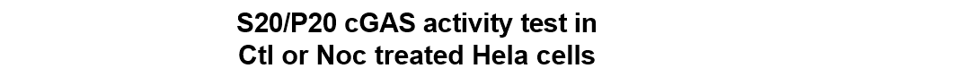
Test of cGAS activity in the Nocodazole treated cells

Slide 9
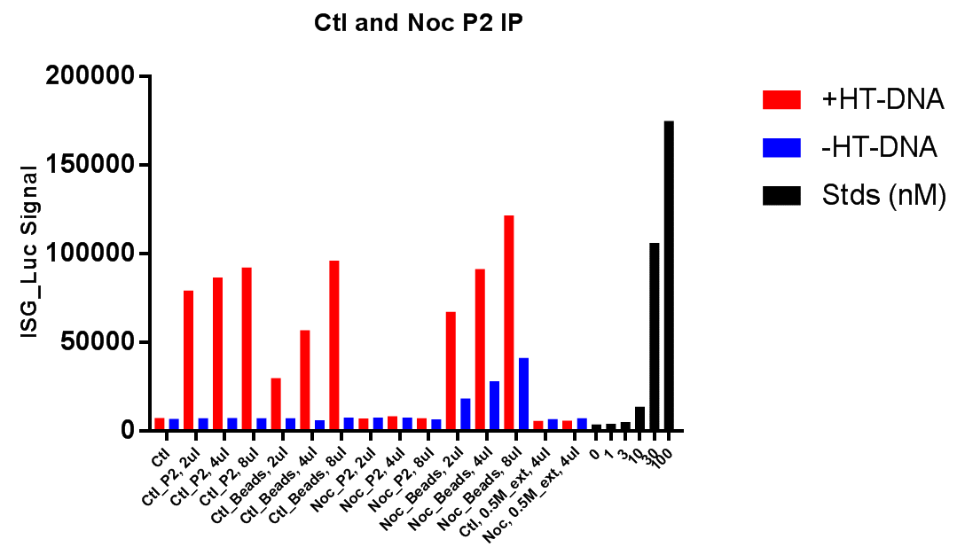
Nuclear fraction(pellet) from Nocodazole treated Hela cell does not have cGAS activity, however, after extraction and IP, the cGAS did have activity, which may exclude the possibility of modification on cGAS that regulates cGAS enzymatic activity.

Slide 12
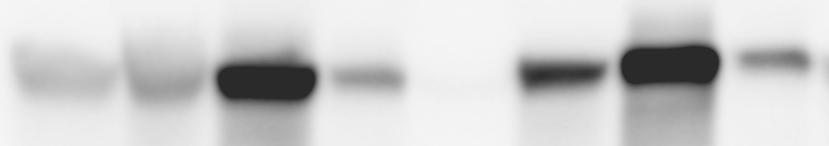
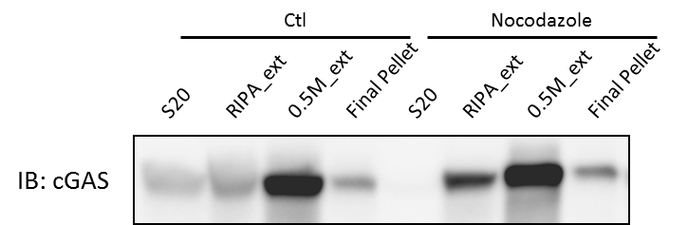
Test of cGAS localization after drug treatment
Ctl
Nocodazole
RIPA_ext
Final Pellet
Final Pellet
S20
0.5M_ext
S20
RIPA_ext
0.5M_ext
IB: cGAS

